Slide 2
Camp Alliance Inc., a state and national award-winning 501(c)3 charitable organization was established in 2010 with the purpose of supporting Service Members, Veterans, and their families (SMVF).
Our mission is to improve the quality of life within the SMVF community by enhancing Department of Defense and State Government programing, though the development of new platforms that provide critical resources in support of the military unit and family readiness.
Jody Bergstrom, Jennifer McCroddan, Laura Hopkins & Billy Goldston

Slide 3
The current state of child care for Military Families
Provide meeting participants with the latest information regarding newly authorized DoD child care pilot programs
Moving Forward with success

Slide 4
Military Child Care in Your Neighborhood (MCCYN) est 2007.
Regular Active Duty Service members, Guard and Reserve members on Active Duty status, and Department of Defense civilian employees are eligible.
DoD requirements for community providers participating in MCCYN include current state license, annual inspection, employee background checks, and accreditation by a DoD-approved national accrediting agency.

Slide 5
PURPOSE: To recognize effort and focus of each state to improve the quality of child care, DoD launched the Military Child Care in Your Neighborhood-PLUS (MCCYN-PLUS) pilot. This pilot will expand the eligibility of local providers to participate in military child care fee assistance through the state quality rating system (QRIS).
4,390 Active Duty Service Members
2,017 Full-time ARNG Federal Soldiers, Airmen & Civilians
Deployment & 30+ day Mobilization orders
Up to $1700 per child
a month based on
Total Family Income

Slide 6
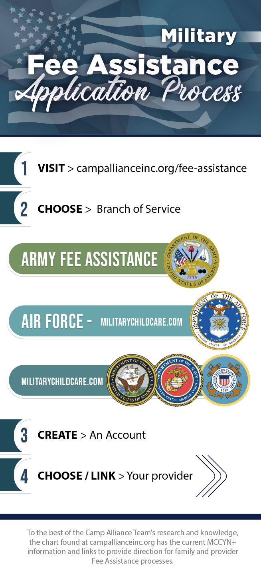
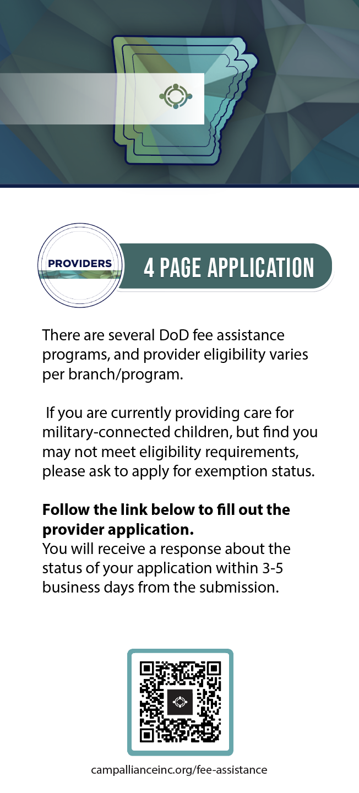

Slide 7
Arkansas branded DoD marketing - Consistent Message
Military families & Providers
Enrollment of Military Families
Joint Communication Plan
Unit Briefs
Enrollment of Providers
DHS, Child care Aware of Arkansas, U of A
QRIS 3 & MCCYN exception (Consistency of Care)
MECC-D - Military Early Childhood Charter District
Expansion of Quality Care

Slide 8
The Military Early Childhood Charter District
Strategic Objective: Initial training pilot site - Fort Smith military region.
Action Items:
Identify early childhood development center location(s) for children 6 weeks to pre-k
Ensure the selected facility is available to provide wrap-around educare 24/7
Build a sustainable growth model for the expansion of foreign sales and training missions
Notes:
Assist center/providers with DoD vouchers/fee assistance compliance and processes

Slide 9
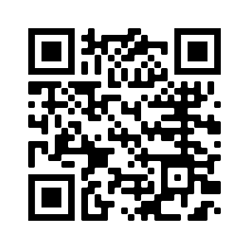
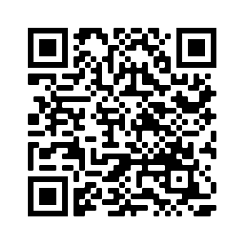
campallianceinc.org/kids247
Find More Information about MCCYN-Plus Expansion & Camp Alliance
To check if your current provider is enrolled and participating in the state QRIS system:
https://arkdhs.force.com/elicensing/s/search-provider/find-providers?tab=CC

